Slide 1


Technical Design Thinking I
Spring 2025
Systems Thinking / Decomposition
Robot Project
Dr. Bruce McFall

Slide 2
Systems Thinking – Advanced Skills
Understand how the behavior of a system changes with time
Indentify feedback processes (positive and negative) to help understand system behavior
Identify inputs and flow relationships
Recognize delays and understand their impact
Identify nonlinearities (complex mathematical relationships)
Recognize the limitations of your models, mental and physical

Slide 3
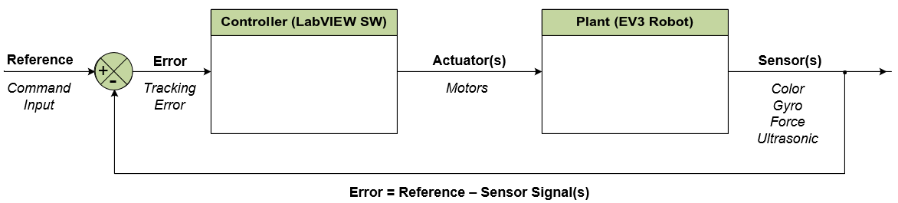
Negative Feedback Control Loop

Slide 4
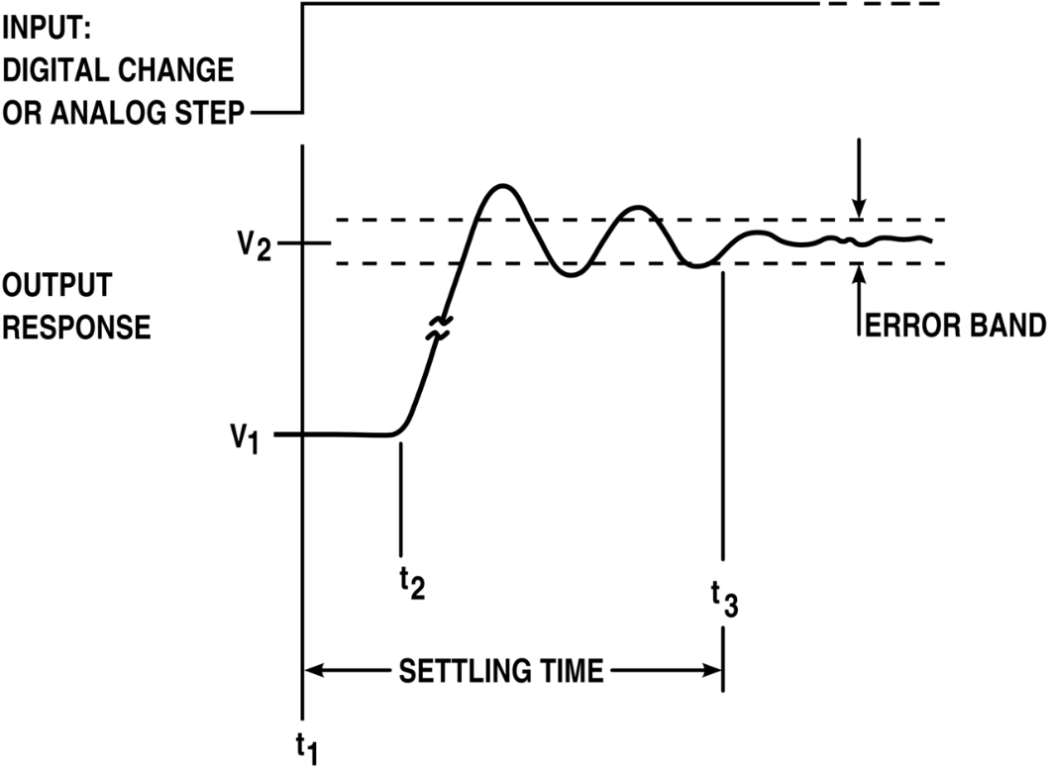
Negative Feedback Control Loop
What does it do?
System Step Response
Decreases Overshoot
Decreases Rippling
Reduces Error Band
Reduces Settling Time

